Slide 1
Last lecture on metabolism is next Monday
Need to schedule a first exam

Slide 2
Polymeric Metabolites

Slide 3
Ribosomes
Fatty Acids
Polyketides
Non-ribosomal Peptides
Polymeric Carbohydrates
Notes:
Ribosomes, Fatty Acids, Polyketides, Non-ribosomal Peptides, and polymeric carbohydrates all share a common property that they involve enzymes that perform multiple chemical reactions during each round of substrate binding. This poses challenges and opportunities for genetically encoding these biomolecules.

Slide 4
Monofunctional Enzymes
E
S
P
Notes:
Monofunctional enzymes make metabolic engineering relatively easy. These are the enzymes that bind to a substrate, do some chemistry, and then release the modified product.

Slide 5
Megasynthases
E
S
P
Notes:
There are additional types of enzymes that similarly can be described by this model of substrate comes in, product comes out, but a large number of reactions take place when the enzyme is associated with the substrate. They operate like an assembly line. Thus, black-boxing the internal function of the enzyme would hide all the interesting details. Without understanding how to manipulate the internal function of the enzyme, you could still refactor it for expression in another host, and in that sense it behaves like any other enzyme, and the reactions it performs should transfer from host to host.
However, you can also manipulate the function of these biomolecules more deeply. For example, let’s say you wanted to change the product to be different in just one *click* region of the molecule. That will require digging into the sequence of the enzyme and changing the portions of the megasynthase that construct that region of the molecule. In this sense, it is an act of protein engineering, not just the usual device project. However, as we examine the inner workings of these megasynthases, you’ll see that they have a great deal of internal structure that allows us to approach their engineering in ways very similarly to how we build pathways from monofunctional enzymes.

Slide 6
The Ribosome
Ribosome
Aminoacyl tRNAs
mRNA
Protein
Notes:
You have already been introduced to one type of megasynthase, the ribosome. It inputs aminoacyl tRNAs and an mRNA and outputs a protein. Since the information about the sequence of the monomers in the protein are defined by the mRNA, you don’t need to worry about modifying ribosomes to make a new protein – you simply create a gene that encodes the protein and the rest just happens. This will not be the case with the megasynthases associated with secondary metabolism. Information about the final structure of the product is defined by the primary sequence of the synthase. So, we need to understand what’s going on inside these large biomolecules to engineer them.

Slide 7
Fatty Acid Synthases
Notes:
Fatty acid synthases produce long lipid chains in the cell such as the acyl chain components of membrane lipids.

Slide 8
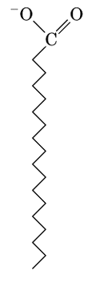
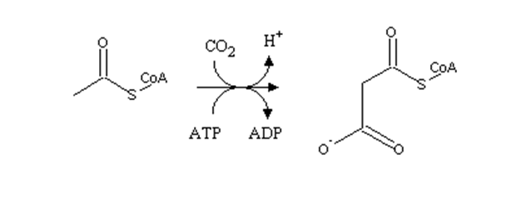
Fatty Acid Biosynthesis
Fatty Acid Synthase
Acetyl-CoA
Malonyl-CoA
Acetyl-CoA Carboxylase
Most Bacteria/Plants have type II or “dissociated” FAS – multiple genes encode a protein complex
Others encode one giant protein with individual domains
Notes:
If we black-box its inner details, we can describe the inputs as acetyl-coA and malonyl-coa and the product is a fatty acid chain. These inputs and outputs are the free-floating, non-complexed molecules. Most bacteria and plants encode fatty acid synthases as multiple polypeptides while others encode it as one giant protein. Whether a megasynthase is composed of one gene or multiple genes is largely immaterial to their function, but it leads to different gene structures at the DNA level.

Slide 9
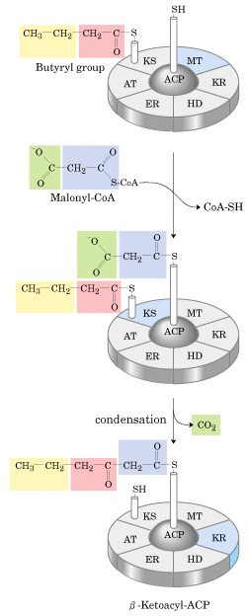
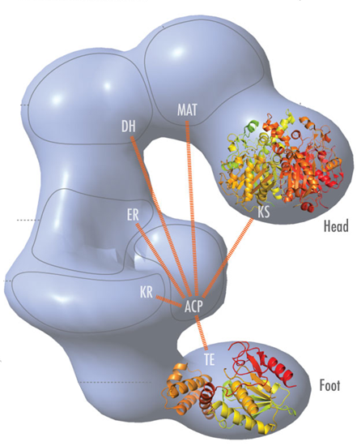
Fatty Acid Synthase
Notes:
FAS inputs one acetyl coA molecule and many malonyl-coa molecules and outputs one acyl chain. First, an acetyl-coA molecule becomes bound by a *click* thioester linkage to the ketoacyl synthase (KS) domain. This two-carbon unit is the initiator for the polymer being made. It will end up on the alkyl end of the fatty acid. Also, a malonyl group is transferred from malonyl-CoA to the *click* ACP domain also as a thioester linkage. The two thioesters are now reacted with one another in the condensation step. Subsequently, additional reactions will occur before the cycle repeats itself growing the enzyme-bound intermediate two carbons at a time until it reaches some length. Once that length is reached, the new fatty acid molecule is released from the enzyme as a free acid by hydrolysis or by transesterification with CoA.

Slide 10
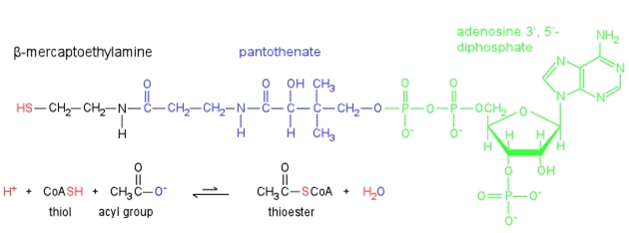
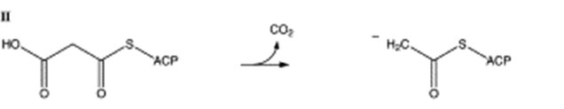
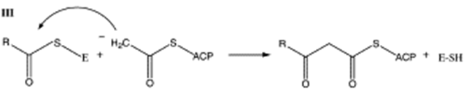
In Detail
Notes:
Let’s go back and look at it in more detail. This all begins with CoA thioesters of acetate and malonate. Coenzyme A is this large molecule whose structure is largely irrelevant except for the presence of a thiol on one end (in red). *click* There are other enzymes in the cell that perform this esterification reaction resulting in the thioesters AcetylCoA and MalonylCoA.
The first step was loading of the acetyl-CoA and malonyl-CoA moieties onto the enzyme. That’s a simple transesterification in which one thiol replaces the other. The result is that CoA is released to the cytoplasm, and the monomer units are now attached to the enzyme.
*click*
In the second step, Malonyl-CoA is decarboxylated leaving behind an enolate. The enolate is nucleophillic, and in the *click* next step it will attack the thioester of the growing acyl chain and in the process transferring it to the ACP domain. We have now joined our monomer to the growing chain.

Slide 11
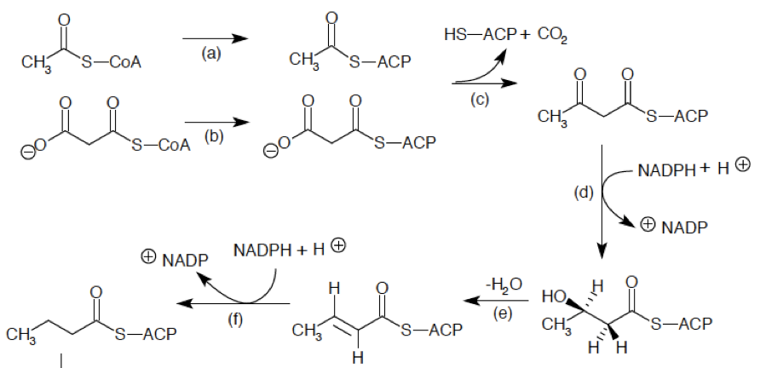
Reduction
Notes:
I’ve grayed out that first step in this diagram which corresponds to the condensation reaction. We now have this di-keto thioester linked to the acyl carrier protein. The fatty acid synthase now reduces this intermediate to the alcohol, eliminates water to make the alkene, and then reduces again to make the fully saturated alkyl chain.

Slide 12
Fatty Acid Synthase
Notes:
Each one of these condensation, reduction, elimination, and alkene reduction steps occurs within a different domain of the megasynthase. Once the cycle is complete, the growing chain remains attached to the ACP and can begin another round of elongation.

Slide 13
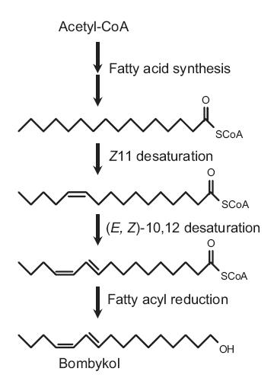
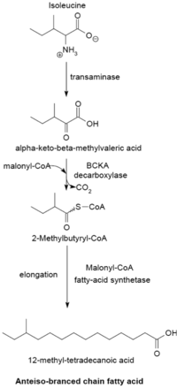
Fatty Acid Derivatives
Tailoring
Alternate Starter Units
Palmitic acid
PMID 17448494
Notes:
The class of fatty acid-derived metabolites includes most membrane lipids, prostaglandins, and insect pheromones. If the synthase performs every reduction step in its cycle for each malonate it adds, the result is a fully-saturated alkyl chain such as Palmitic acid shown here. Those intermediates can be released as free acids or CoA derivatives. At this step of biosynthesis, we can black-box the fatty acid synthase because our fatty acids are no longer associated with the synthase. A large number of lipid variants operate by tailoring of this complete fatty acid chain. Here, the insect pheromone bombykol is biosynthesized by two rounds of oxidation to double bonds followed by reduction of the thioester to a free hydroxyl group. This process of modifying a molecule after it has left some type of megasynthase is called a ‘tailoring’ reaction. The logic of allowed reactions for tailoring is no different than any other case involving monofunctional enzymes, thus we do not need to consider it as a separate subject.
*click*
However, there are other types of things that can happen that do not allow you to black-box fatty acid biosynthesis. Here, the amino acid isoleucine is converted to a CoA thioester which replaces acetyl-coa as the initiating unit for a synthase. The resulting product has a branched structure at the end.

Slide 14
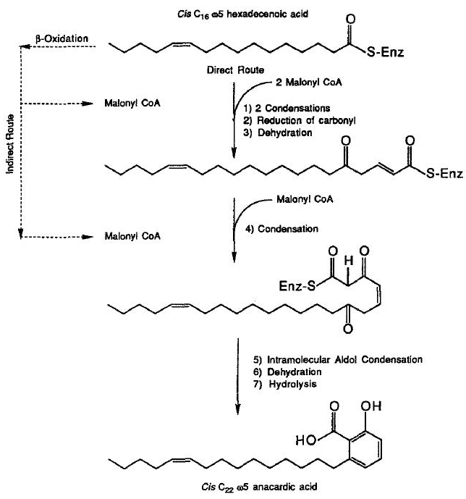
Fatty Acid Derivatives
It’s not always clear whether a pathway involves soluble intermediates or not
Journal of Chemical Ecology, VoL 18, No. 8, 1992, p1349-1364.
Notes:
Still other lipid biosynthesis pathways involve intervention while the fatty acid is under construction, or tailoring steps may be performed while the substrate is still covalently attached to the synthase. In this example of anacardic acid biosynthesis, a series of atypical modifications happens while the fatty acid is attached to the enzyme. Additionally, the system begins with loading of complete fatty acids. Thus, this pathway breaks the simple monofunctional model in complicated ways. It is not always clear whether a pathway involves soluble intermediate or not, and this is particularly true for fatty acid-based secondary metabolites.

Slide 15
Draw out one step of fatty acid biosynthesis showing the structures of the intermediates and pushing the arrows.

Slide 16
Type II Polyketides
Notes:
There are 3 classes of Polyketides. The simplest to describe are the Type II.

Slide 17
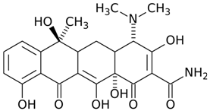

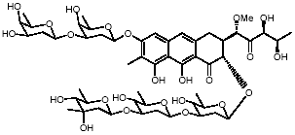

Type II Polyketides
Tetracycline
Jadomycin
Actinorhodin
Mithramycin A
Notes:
The most obvious characteristic of this class is a large carbon skeleton with several fused rings. Many antibiotics, such as tetracycline are within this class.

Slide 18
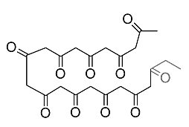
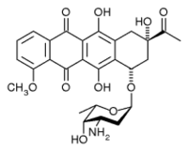
Type II Polyketide Biosynthesis
PKS
Acetyl-CoA
Malonyl-CoA
Tailoring Enzymes
Daunorubicin
Notes:
Type II polyketides behave much like the simple fatty acid synthase system. Nothing special happens coincident with polymerization of the polyketide. An acetyl-CoA and many malonyl-CoA molecules go in, and a simple polymer comes out that contains many ketones as a soluble intermediate.

Slide 19
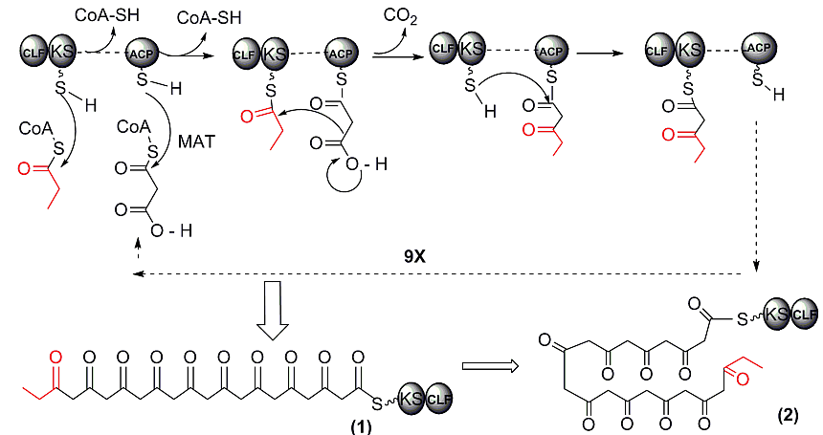
Type II polyketide synthase (PKS)
KS: ketosynthase
CLF: chain length factor
ACP: acyl carrier
See http://www.pharmacy.arizona.edu/faculty/moorelab/classes/chem549/2_polyketide.pdf for more detail
Notes:
The reaction catalyzed by a polyketide synthase is the same one we saw before with fatty acid synthase. It begins with the initiating unit on the enzyme, it loads a malonate, the malonate is decarboxylated to the enolate, and the enolate attacks the growing polymer chain. Like FAS, the polyketide synthase cycles a growing polymer chain through multiple rounds of polymerization using the same domains over and over resulting in a repetitive polymer. In the end, that polymer is released from the synthase.

Slide 20
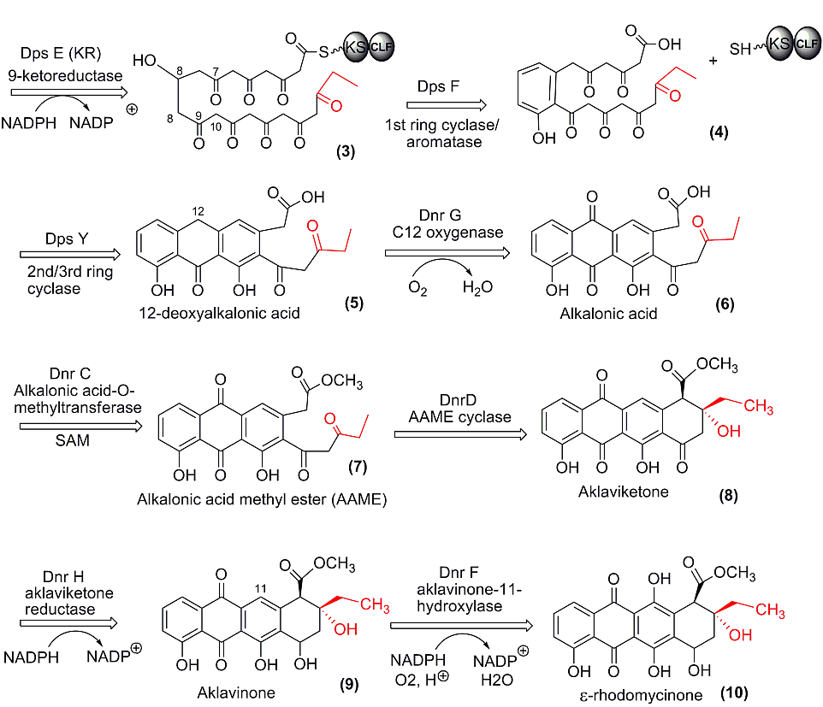
Type II Biosynthesis: Anthracycline Antibiotics
Notes:
The rest of type II polyketide biosythesis is about tailoring. A molecule with this many closely-spaced ketones is a highly-reactive molecule. The ketone is both a highly reactive nucleophile on each alpha carbon, and also a highly reactive electrophile on each carbonyl carbon. Thus, a molecule like this is primed to undergo intramolecular reactions. Hence, many of these tailoring steps involve the closure of rings and further oxidation steps. In this regard, type II biosyntheses are similar to terpenoid pathways. Though the chemistry is unrelated, the downstream steps are very similar for the two types of pathway. First a highly-reactive intermediate is generated, and then cyclases cause intramolecular reactions to occur forming rings. Those structures are then oxidized at various places and often decorated further with sugars, methyl groups, and so forth.

Slide 21
Type I Polyketides
Notes:
When people speak of polyketides, they most often are talking about Type I polyketides.

Slide 22
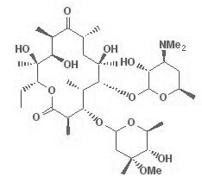
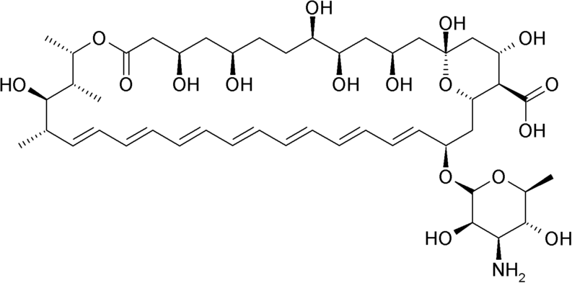
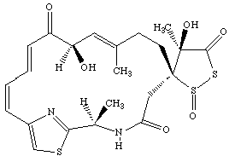
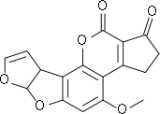
Type I Polyketides
Amphotericin
Erythromycin
Leinamycin
Aflatoxin
Notes:
The class is typified by very long carbon chains that are mostly linear. Unlike the Type II’s, there will be no large highly-reactive soluble intermediate. Instead, the type I’s ‘finish’ each elongation step while it is on the megasynthase. Each two-carbon unit can be finished in one of several forms that include *click* alcohols of different chirality, *click* olephins, and *click* methyl groups.

Slide 23
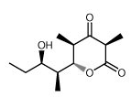
Type I Polyketide Biosynthesis
PKS
Various Carboxylic Acid and CoA derivatives
Notes:
The ‘black box’ description of the Type I PKS is an enzyme that inputs a list of carboxylic acid and malonyl-coa derivatives and outputs an elaborately structured carbon moiety.

Slide 24
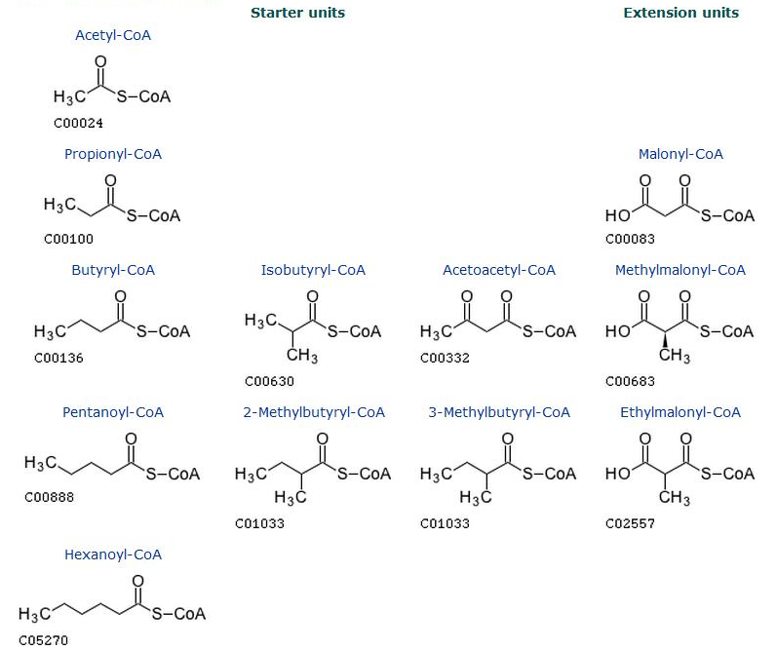
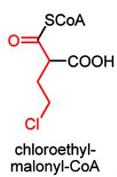
Building blocks for polyketides
PMID 19590008
Notes:
A great many *click* starter units can be used. They all need to be CoA thioesters, but that is the only chemical requirement. It is common to have unusual and large starter units for type I biosyntheses. There is similarly some diversity around the choice of *click* extension units. The most common ones are Malonyl-CoA and its methylated derivative methyl malonyl-coa. However, others including olephins, amines, ethyl groups, and chlorines are sometimes observed.

Slide 25
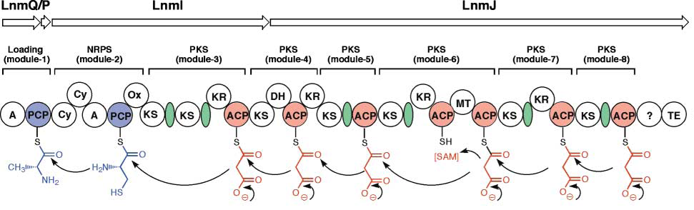
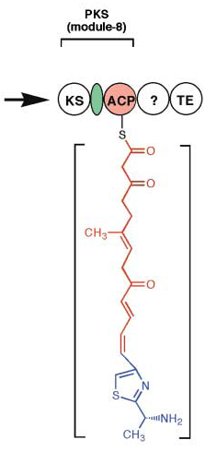
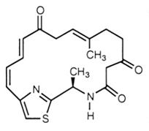
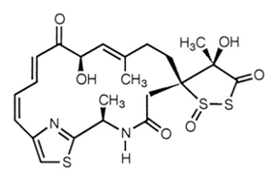

Polyketide Biosynthesis
Leinamycin
Notes:
Here we have an example of a PKS that illustrates many of the diverse features of the class. First off, there is no cycling of intermediates in a type I PKS like there was in fatty acid and Type II PK biosynthesis. Each elongation step will be handled by a dedicated module of the synthase. *click* Here you see 6 of these modules. At the *click* primary sequence level, these modules do not necessarily correlate with polypeptides. This entire megasynthase is composed of 4 genes that do not correlate with the module boundaries. So, we have one level of organization called “modules” that correlate with the addition of one malonate unit. *click* Within each one of these modules, there is another level of organization of “domains” that each perform a specific step in the condensation and modification of each added monomer.

Slide 26
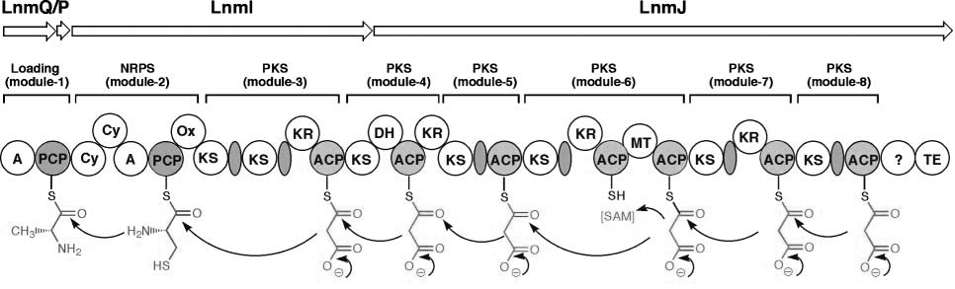
Polyketide Synthase (PKS)
Acyl Carrier Protein (ACP): domains with 4'-phospho-pantetheine providing the thiol that is loaded with the carboxylic acid
Notes:
Each elongation module encodes an Acyl Carrier Protein, or ACP, domain which is how the growing chain is attached to the megasynthase. Each ACP is modified with a phospho-pantetheine linker which provides the thiol which attaches to the growing chain as a thioester.

Slide 27
Polyketide Synthase (PKS)
Ketosynthase (KS domain): select and load the malonyl-CoA derivative onto the ACP, and catalyze the Claisen condensation
Notes:
Each domain also has a Ketosynthase (or KS) domain. The KS selects the malonyl-coA derivative and attaches it to the ACP. It also catalyzes the condensation reaction between the growing chain and its chosen malonate.

Slide 28
Relation to Fatty Acid Synthase
Notes:
Note that we are doing the exact same chemistry we did before with Fatty acid synthase, and with just a KS and an ACP domain, we’d get to *click* this alpha-keto molecule. If we were to proceed with a fatty acid-like synthesis, the next step would be to reduce the ketone with NADPH.

Slide 29
Polyketide Synthase (PKS)
Ketoreductase domains (KR): Reduce the newly-formed ketone to an alcohol, introduces stereochemistry in the process
Notes:
Those modules that contain a Ketoreductase, or (KR) domain will perform this reduction resulting in the alcohol. Since there are two stereochemical outcomes of this reduction, the KR is responsible for choosing which stereoisomer gets produced.

Slide 30
Relation to Fatty Acid Synthase
Notes:
The next step in fatty acid synthase was elimination of water to make the olefin.

Slide 31
Polyketide Synthase (PKS)
Dehydratase (DH): Eliminate water from a newly-reduced alcohol to make an alkene
Notes:
Modules with a DH, or Dehydratase Domain will similarly eliminate water.

Slide 32
Polyketide Synthase (PKS)
Methyltransferase domains (MT): Use S-adenosyl methionine as a methyl source
Notes:
Unlike fatty acid synthase, PKS modules can contain Methyltransferase Domains (or MTs) that will methylate newly-formed alcohols. Because there needs to be an alcohol to methylate, a module with an MT would have a KR but no DH.

Slide 33
Polyketide Synthase (PKS)
Notes:
At the N and C termini of the synthase are the loading and thioesterase domains, respectively. The loading domains are responsible for choosing the first carboxylic acid that initiates the polymer. The thioesterase domains are responsible for releasing the polyketide from the synthase by breakage of the thioester linkage.

Slide 34
Polyketide Synthase (PKS)
Thioesterase domains (TE): Hydrolyzes the newly formed polyketide off the synthase, in this case using an amino group on the molecule as a nucleophile to make a macrolactam
Notes:
Thioesterase domains solve the task of releasing the product in various ways. For example, the polyketide could be release as a free acid by hydrolysis, or it could be reduced off to a ketone. Here we have one that produces a macrolactam. An amino group in the starting unit attacks the thioester producing an intramolecular amide and release.

Slide 35
Polyketide Synthase (PKS)
Adenylation (A) Domain: Uses ATP to activate the carboxylic acid then transfer onto the Peptide Carrier Protein (PCP domain)
Notes:
The loading domains for a PKS can be very simple such as an ACP that loads acetyl-coA or malonyl-coA. In our example, we instead begin with alanine and serine amino acids. Amino acids aren’t normally formed as CoA derivatives in the cell. Instead, Adenylation Domains use ATP to activate the amino acid for transesterification onto the megasynthase.

Slide 36
Polyketide Synthase (PKS)
Peptidyl Carrier Protein (PCP) Domains: Analagous to an ACP but hold amino acids instead
Notes:
The adenylation domains transfer the amino acid to a PCP domain. These play the same role as ACP domains in the other modules. There are some additional things like Cy and Ox that I still need to explain, and we’ll come back to those later.

Slide 37
Summary
Type I Polyketide Synthases do the same reactions that fatty acids do
One module corresponds to one 2-carbon extension unit
Many choices of monomers
Often form large rings
Notes:
Type I Polyketide Synthases do the same reactions that fatty acids do. They just don’t necessarily do all of them resulting in a diversity of oxidation states at each 2 carbon unit.
Each module of the synthase corresponds to the elongation by one 2-carbon unit in from a malonyl-coa molecule. The modules are not reused or cycled-through by the substrate.
There are many choices of monomers for both the initiating acid and the extending malonates
The mechanisms of termination are also diverse and can result in large rings by intramolecular transesterification.

Slide 38
Non-Ribosomal Peptides
Notes:
Non-ribosomal peptides chemically look like proteins, but are biosynthesized in a way that resembles polyketides.

Slide 39
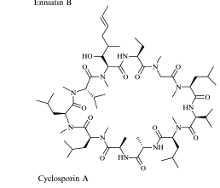
Non-Ribosomal peptides (NRPs)
Notes:
They are recognizable base on, first and foremost, *click* a peptide backbone. It is also typical to see *click* modified side chains on the amino acids, or *click* methylation of the peptide backbone.

Slide 40
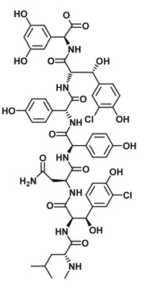
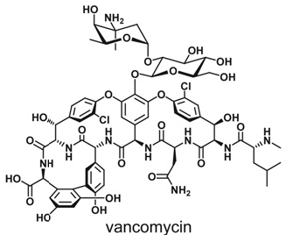
Nonribosomal Peptides
Natural and Unnatural Amino Acids
Various Cofactors
NRP Synthetase
Tailoring Enzymes
Notes:
As a black box, a NRPS inputs amino acids and various cofactors such as S-adenosyl methionine and ATP, and outputs a polypeptide.

Slide 41
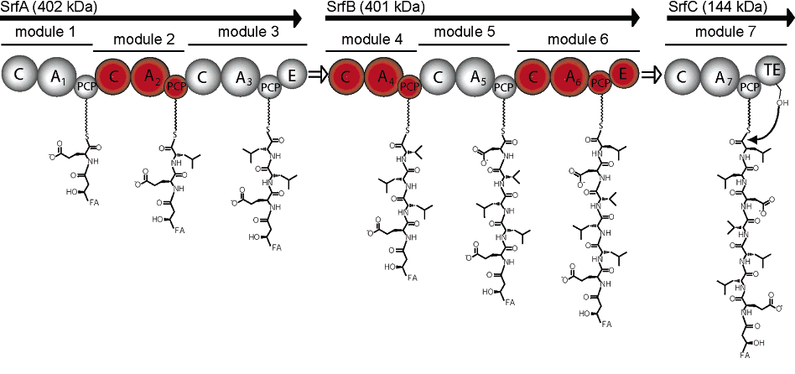
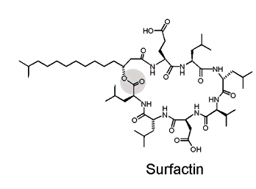
Notes:
Like Type I polyketides, non-ribosomal peptides are organized as modules which are further organized in domains. Each module is responsible for choosing an amino acid and adding it to the growing chain.

Slide 42
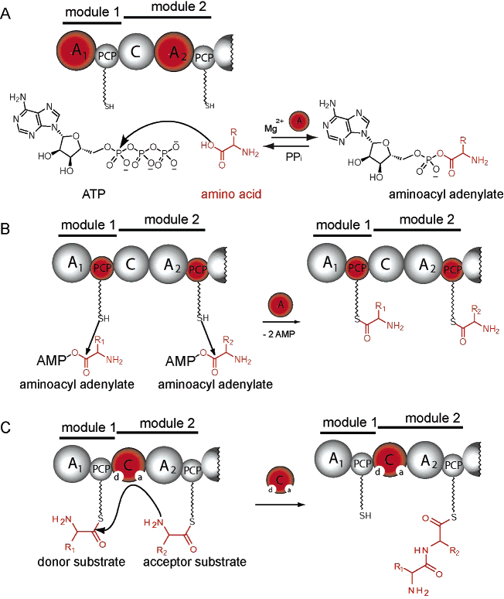
Activation (A) Domain recognizes the amino acid
Peptidyl Carrier Protein (PCP) Domain gets aminoacylated by the amino acid
Condensation (C) domain transfers the amino acid to the next module
Can have editing, epimerization, oxidation, methylation, reduction domains
At the end of the synthase have a Transesterification (TE) domain
Notes:
Each domain typically has an A, PCP, and C domain. *click* Activation (A) domains recognize the amino acid, activates it through reaction with ATP, and transfers it to the *click* peptidyl-carrier protein, or PCP. The *click* condensation domain, called C, catalyzes the transesterification of the chosen amino acid onto the amino end of the growing peptide. In addition to these three domains, a module can contain *click* methylation domains to add a methyl group to the amine in the backbone, oxidation, epimerization, and reduction domains. These domains create additional diversity through modification of the peptide backbone. At the end of the synthase will be a *click* transesterification domain to release the peptide. This last step is analogous to that of PKS systems and similarly can lead to macrolactams, macrolactones, or free acids.

Slide 43
Polyketide Synthase (PKS)
Notes:
It is very common to see hybrid PKS/NRPS products. The two classes of proteins are evolutationarily related and structurally similar. Usually it is the peptide built first which is used as the initiating carboxylic acid for PKS polymerization. Here we have primarily a polyketide synthase, but it is initiated with an amino acid and one step of non-ribosomal peptide formation. In the final product, there is a thiazole that originated as alanine and serine. This is the portion of the molecule built by the NRPS domains.

Slide 44
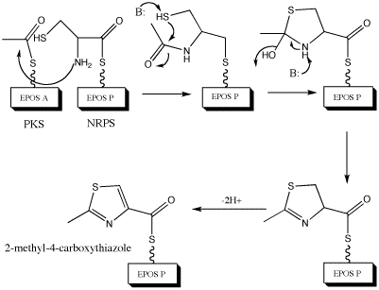
Polyketide Synthase (PKS)
Condensation/Cyclization (Cy domain) and Oxidation (Ox domain): Perform a reaction of amino acids in which the cysteine and alanine condense onto each other to form the thiazole
Notes:
We have already discussed the role of A and PCP domains. This NRPS module also contains Cy and Ox domains. These are alternates to the C domain we saw in the more typical case. They perform the condensation step but also the cyclization of the cysteine side chain with the backbone to form a ring, and subsequent oxidation of the heterocycle to a thiazole.

Slide 45
Polymeric Carbohydrates
Notes:
Polymeric carbohydrates are often produced and secreted from cells. In bacteria, they make up the peptidoglycan, cell wall, or capsular polysaccharides. Many organisms secrete various carbohydrates, and carbohydrates associated with proteins are particularly common in animal systems. The most famous of member of this class is cellulose, but many others exist.

Slide 46
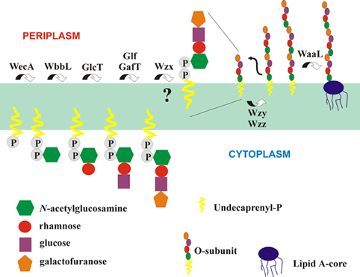
Polymeric Carbohydrates: O-antigens
Feldman et. al.(1999) Journal of Biological Chemistry 274:35129-35138.
Notes:
I’m only going to talk about one type of polymeric carbohydrate today, O-antigens. However, similar themes are present throughout this class. We’re looking here at the inner membrane of a prokaryote showing carbohydrate biosynthesis occurring on both sides of the membrane. Oligosaccharides are first synthesized on the periplasmic face anchored to the membrane. They are then shuttled across the membrane and polymerized on the surface of the cell. In a gram-negative bacterium, this polymerization occurs on the outer membrane and gives rise to a surface coating of a particular structure of sugars. These capsular polysaccharides play major roles in the interactions between the bacterium and other organisms.

Slide 47
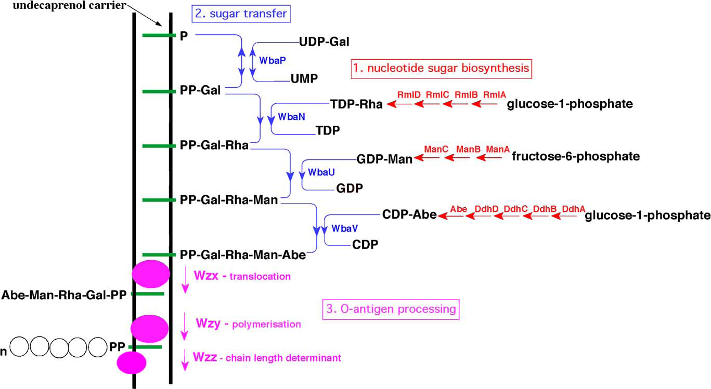
Polymeric Carbohydrates: O-antigens
O-antigens are “capsular polysaccharides” that coat bacterial surfaces and are important in pathogenesis and environmental survival (biofilms and dessication protection). They are of interest as new materials.
Notes:
The general organization of an O-antigen invovles a core structure composed of maybe 4 or 5 monosaccharides in a specific configuration. This oligosaccharide is synthesized attached to a lipid linker called undecaprenol which is a terpenoid. Beyond the fact that the substrate is anchored to the membrane, the biosynthesis of the oligosaccharide involves normal monofunctional enzymes.

Slide 48
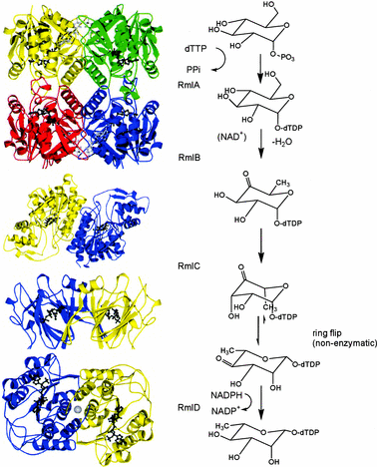
Polymeric Carbohydrates: O-antigens
Notes:
The product of each step is substrate for the next enzyme and involves free soluble enzymes and substrates at each step.

Slide 49
Polymeric Carbohydrates: O-antigens
Notes:
In the later stages of the biosynthesis, shown in pink, a series of more complicated events occurs. The oligosaccharide is transported across the membrane to the cell surface where it undergoes polymerization. Typical lengths are 40 but the chains are polydisperse in length. The mechanism of determining chain length is a current subject of study. Some of these ‘capsular polysaccharides’ are transferred to proteins after polymerization, while others are hydrolyzed or attached to other lipid components of the outer membrane. Though these polymerases are biochemically quite distinct from the PKS, NRPS, or FAS systems, in terms of complexation states and the production of polymers they belong to a related functional class.

